Slide 1
Artificial Intelligent With Data Science
28/07/2019

Slide 2
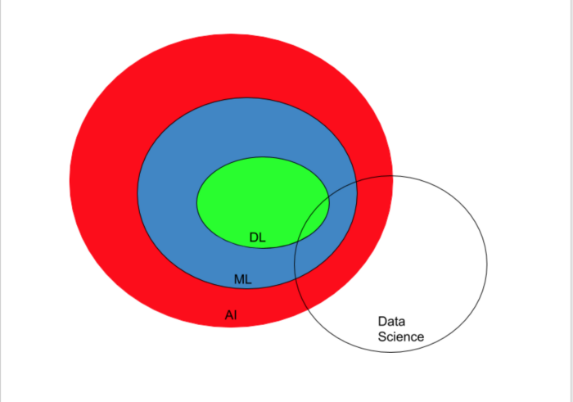
Simple Representation(AI,ML,DL&DS)

Slide 3
Artificial intelligence
Artificial intelligence (AI) is therefore, based on the idea of the capability of a machine or computer program to think(reason), understand and learn like humans.
Example of AI
if you watch a particular category of movies on Netflix for example, Netflix starts making movie suggestions to you , based on your watch pattern.
How is this possible? Artificial intelligence. This is a very general example of Artificial intelligence.

Slide 4
Machine Learning
Artificial intelligence is very vast. Machine learning(ML) is a subset of Artificial Intelligence
Machine learning(ML) is a set of statistical tools to learn from data. The nucleus of ML is in teaching computers how to learn and make predictions from data without necessarily being programmed.
Example of MI
We all get spam mails. These are always filtered out by gmail for example. Also, mails are categorised as promotions and social, as well as other categories based on the mail service you use. How has gmail learnt to do this? Machine learning! Don’t forget ML is part of AI.

Slide 5
Deep Learning
‘Deep’ refers to many steps in this case. The output of one step is the input for another step, and this is done continuously to get a final output. All these steps are not linear. An example of a non-linear transformation is a matrix transformation.
Deep learning is sometimes called deep neural networks(DNN) because it makes use of multi-layered artificial neural networks to implement deep learning.
Seen a photo of a neuron from the human brain? Artificial neural networks are built similarly, with neural nodes connected like a web
Example of Deep Learning
Text to voice systems(With deep learning, systems are learning to mimic human voices to the point where it is hard to distinguish between a human and a computer voice-over)
Deep learning is a subset of ML which is a subset of AI, so it is AI.

Slide 6
Data Science
Data science has an intersection with artificial intelligence but is not a subset of artificial intelligence.
Data science is the study of an aroused curiosity in any given field, the extraction of data from a large source of data related to the question in mind, processing data, analysing and visualising this data, so as to make meaning out of it for IT and business strategies.
In simple terms, it is understanding and making sense of data. A lot of tools are used in data science. They include statistical tools, probabilistic tools, linear and metric algebra, numerical optimisation and programming.
Example of Data Science
Stock Prediction

Slide 7
Core technique in Data Science
Process of
Collecting Data,
Cleaning Data,
Analyzing Data,
Modeling Data
and Visualizing Data

Slide 8
NumPy
NumPy is the fundamental package for scientific computing with Python. It contains among other things:
1. A powerful N-dimensional array object
2. Sophisticated (broadcasting) functions
3. Tools for integrating C/C++ and FORTRAN code
4. Useful linear algebra, Fourier transform, and random number capabilities

Slide 9
Pandas
Pandas is for data manipulation and analysis. Pandas is an open source, BSD-licensed library providing high-performance, easy-to-use data structures and data analysis tools for the Python programming language. Pandas is a NumFOCUS sponsored project. This will help ensure the success of development of pandas as a world-class open-source project, and makes it possible to donate to the project.

Slide 10
Matplotlib
Matplotlib is a Python 2D plotting library which produces publication quality figures in a variety of hard copy formats and interactive environments across platforms. Matplotlib can be used in Python scripts, the Python and IPython shells, the Jupyter notebook, web application servers, and four graphical user interface toolkits.

Slide 11
Seaborn
Seaborn is a Python data visualization library based on matplotlib. It provides a high-level interface for drawing attractive and informative statistical graphics.

Slide 12
Scikit-Learn
It is on NumPy, SciPy and matplotlib, this library contains a lot of effiecient tools for machine learningand statistical modeling including classification, regression, clustering and dimensionality reduction. Please note that scikit-learn is used to build models.

